Slide 1

COVID-19
and the
US Economy
CS-559-WS Final Project Presentation
Group 3
Maria Trifonova, Tianyi Li, David Cortinas, John Dyer, Gil Austria

Slide 2

00
Project Overview
01
02
03
Research Question 1
Research Question 2
Research Question 3
04
Conclusion
Agenda

Slide 3
00
Project Overview

Slide 4
Research Topic
COVID-19 and the US Economy
Research Questions:
What types of data/news from COVID-19 is a better predictor of the economy: Sentiment from Social Media Posts by People or Factual COVID-19 Statistics released by Verified Institutions?
Did less consumer movement/outdoor activity negatively affect the economy and the online shopping?
Can we use Consumer Movement to predict rates of COVID-19 transmission?

Slide 5
Data Sources Overview
Research Question 1
Research Question 2
Research Question 3
Data Sources:
COVID-19 Data Repository by the Center for Systems Science and Engineering (CSSE) at Johns Hopkins University
https://github.com/CSSEGISandData/COVID-19
COVID-19 Tweets
https://ieee-dataport.org/open-access/coronavirus-covid-19-tweets-sentiment-trend-global
S&P 500 Index
https://finance.yahoo.com/quote/p=^GSPC
Data Sources:
Disney Stock
https://finance.yahoo.com/quote/DIS
Amazon Stock
https://finance.yahoo.com/quote/AMZN
Google COVID-19 Community Mobility Reports
https://www.google.com/covid19/mobility/
S&P 500 Index
https://finance.yahoo.com/quote/p=^GSPC
Data Sources:
COVID-19 Data Repository by the Center for Systems Science and Engineering (CSSE) at Johns Hopkins University
https://github.com/CSSEGISandData/COVID-19
Google COVID-19 Community Mobility Reports
https://www.google.com/covid19/mobility/

Slide 6
01
Research Question 1
What types of data/news from COVID-19 is a better predictor of the economy: Sentiment from Social Media Posts by People or Factual COVID-19 Statistics released by Verified Institutions?

Slide 7
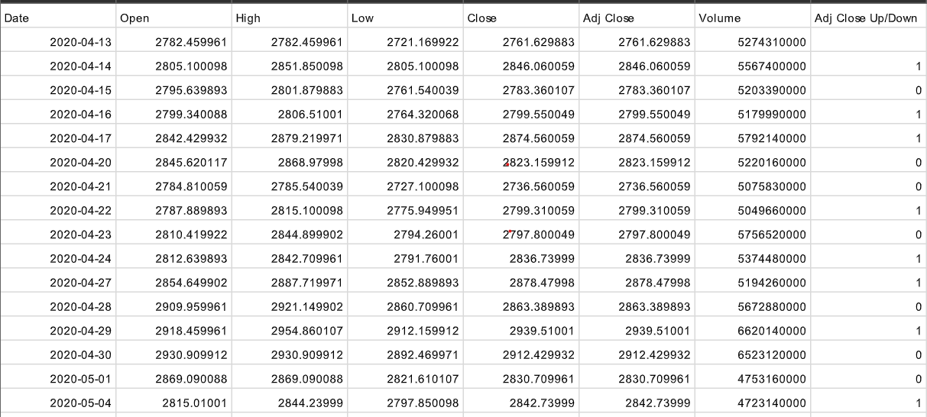
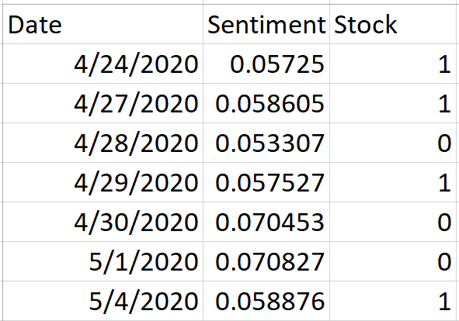
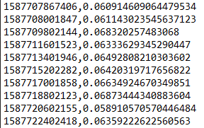
Sentiment Model 1
Data

Slide 8
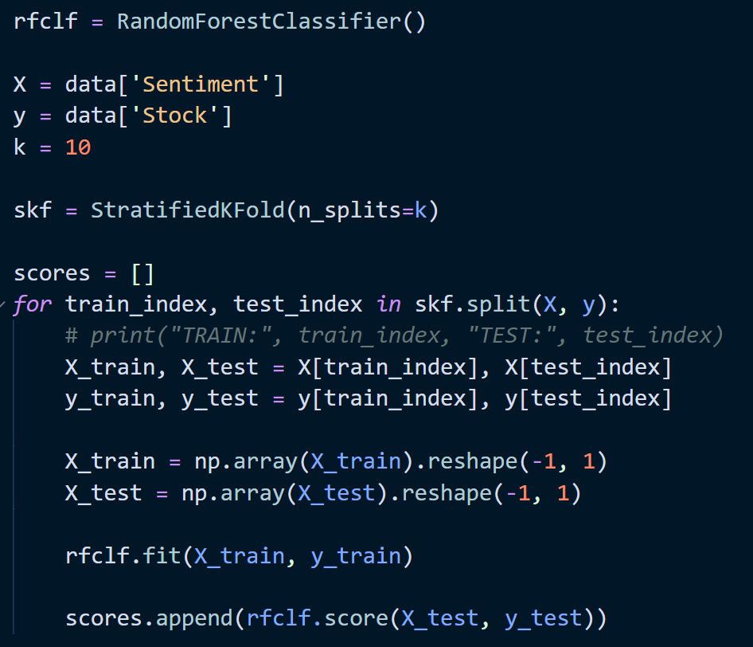
Sentiment Model 1
Model Training
Random Forest Classifier
StratifiedKFold Cross Validation

Slide 9
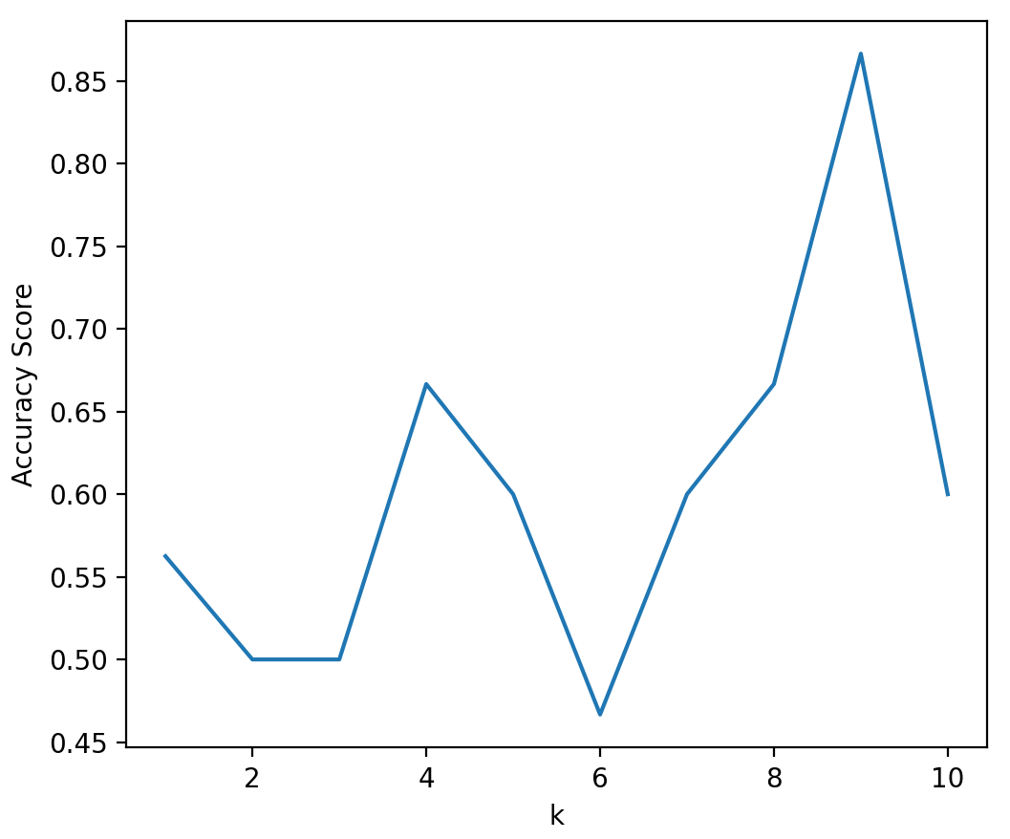
Sentiment Model 1
Results
Average Accuracy: 60.29%
[0.5625, 0.5, 0.5, 0.6666666666666666, 0.6, 0.4666666666666667, 0.6, 0.6666666666666666, 0.8666666666666667, 0.6]

Slide 10
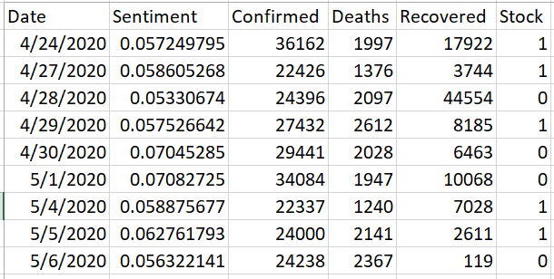
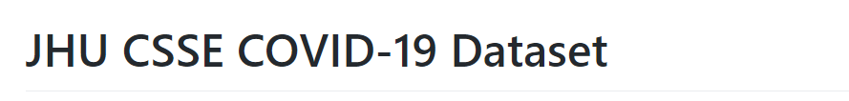
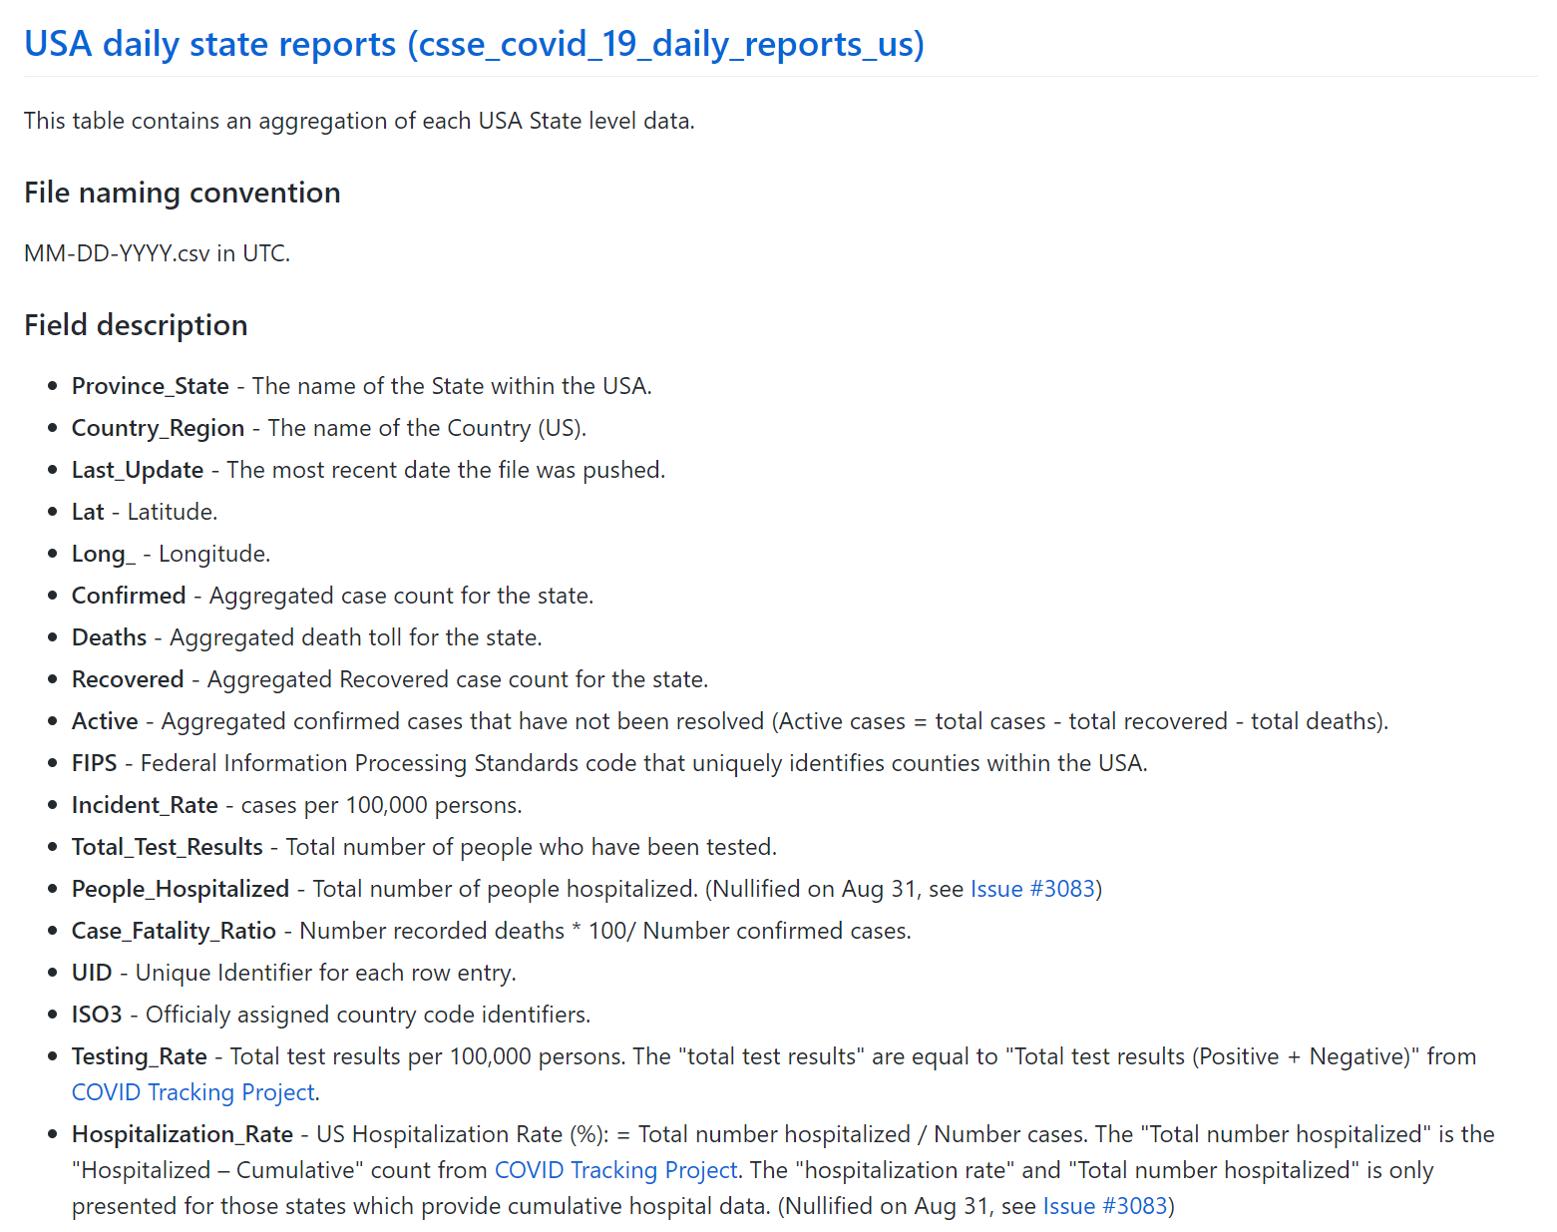
Sentiment Model 2
Data

Slide 11
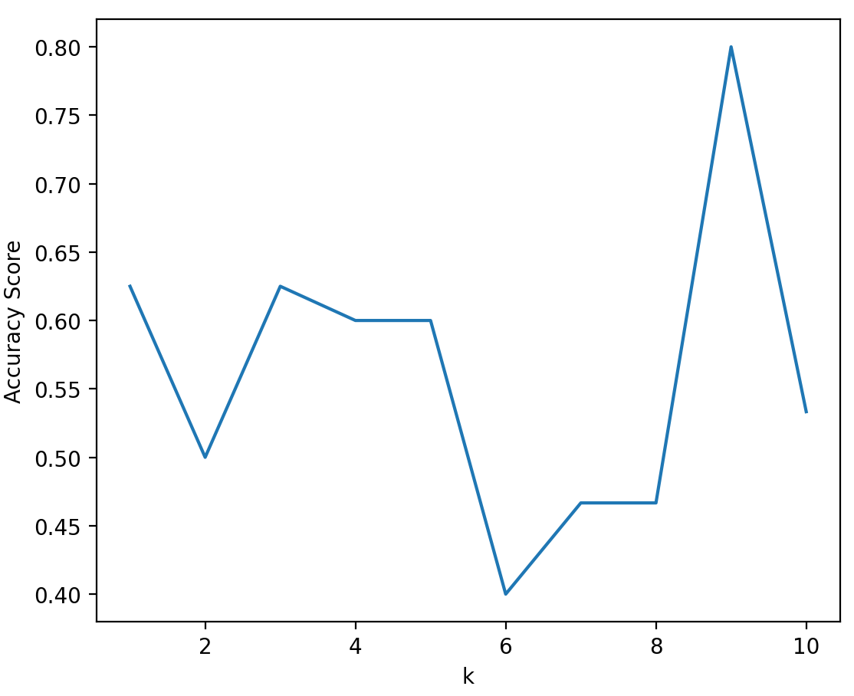
Sentiment Model 2
Results
Average Accuracy: 56.16%
[0.625, 0.5, 0.625, 0.6, 0.6, 0.4, 0.4666666666666667, 0.4666666666666667, 0.8, 0.5333333333333333]

Slide 12
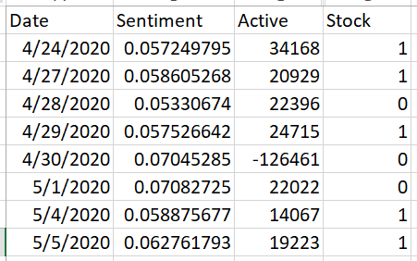
Sentiment Model 3
Data

Slide 13
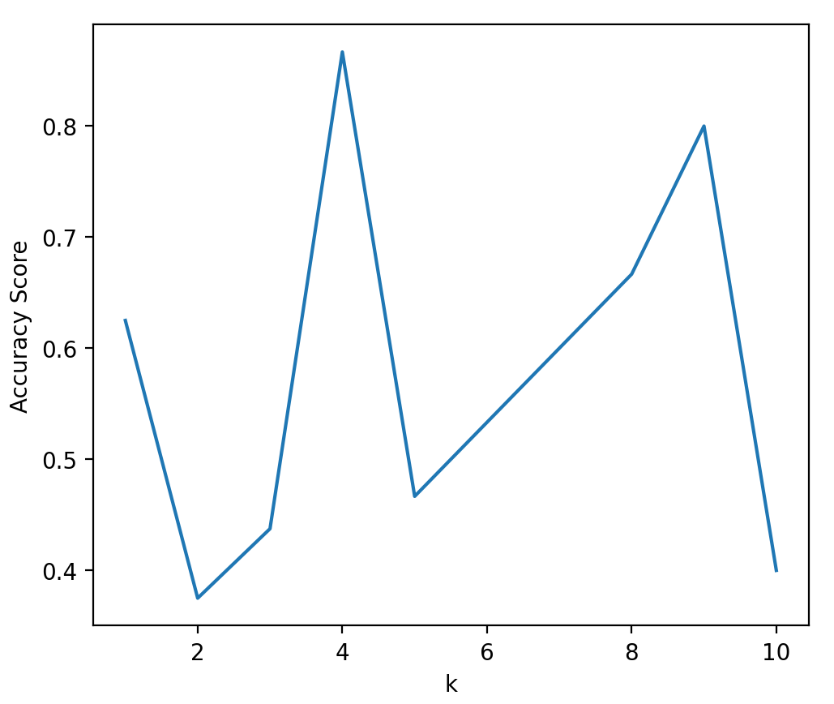
Sentiment Model 3
Results
Average Accuracy: 57.71%
[0.625, 0.375, 0.4375, 0.8666666666666667, 0.4666666666666667, 0.5333333333333333, 0.6, 0.6666666666666666, 0.8, 0.4]

Slide 14
Summary
Sentiment Model performed best overall
COVID-19 Factual Model and Combined Sentiment and Factual Model performed about the same
Accuracy was relatively low and fluctuated greatly in both cases

Slide 15
02
Research Question 2
Did less consumer movement/outdoor activity negatively affect the economy and the online shopping?

Slide 16
Data From 2/18/2020 to 12/02/2020
Used google Consumer Mobility data including:
Retail & Recreation
Grocery & Pharmacy
Parks
Transit Stations
Workplaces
Residential
Source: https://www.google.com/covid19/mobility/
Use S&P 500 Index as a proxy for the general US economy
Source: https://finance.yahoo.com/quote/%5EGSPC/history?p=%5EGSPC
Use Amazon stock as a proxy for the online shopping sales
Source: https://finance.yahoo.com/quote/AMZN/history?p=AMZN

Slide 17
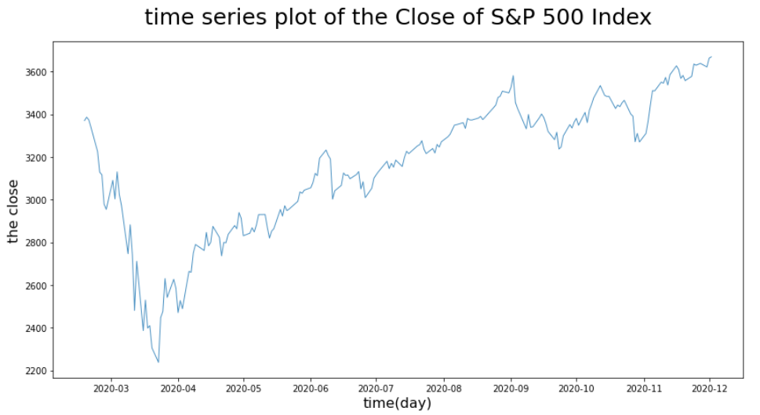
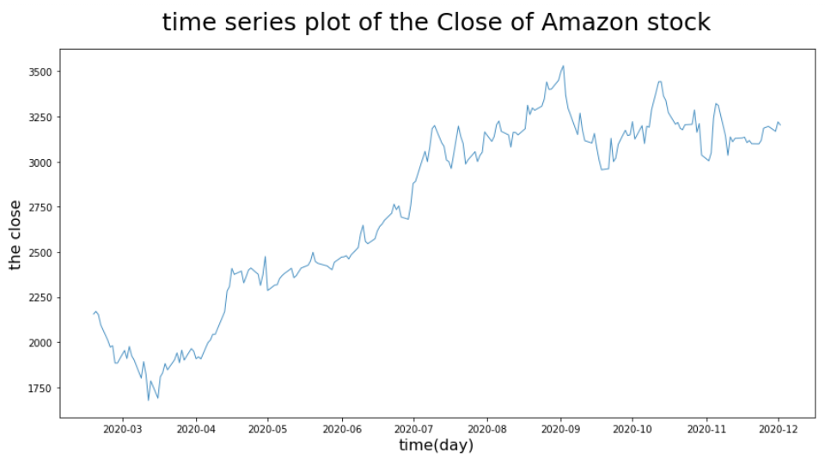
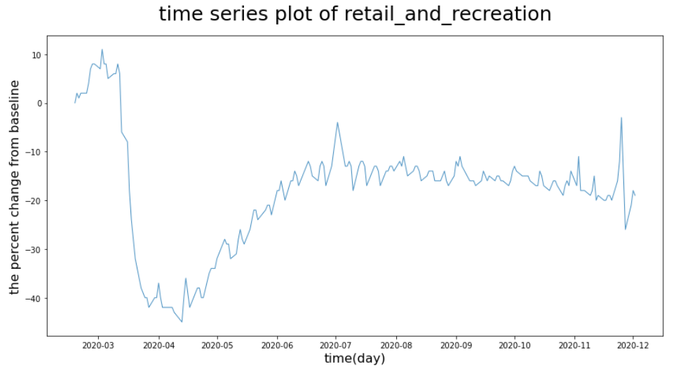
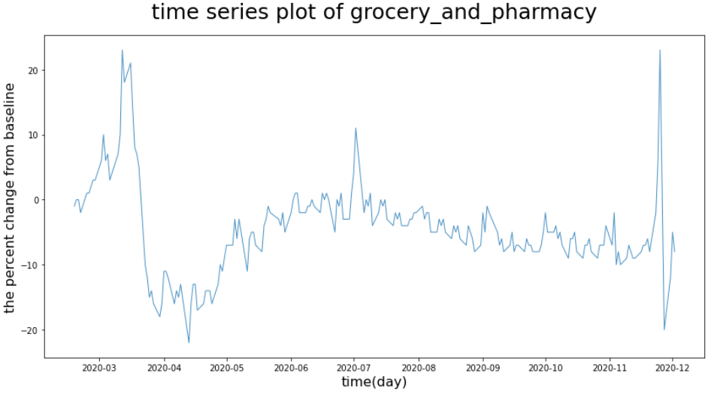
EDA Time Series Plot

Slide 18
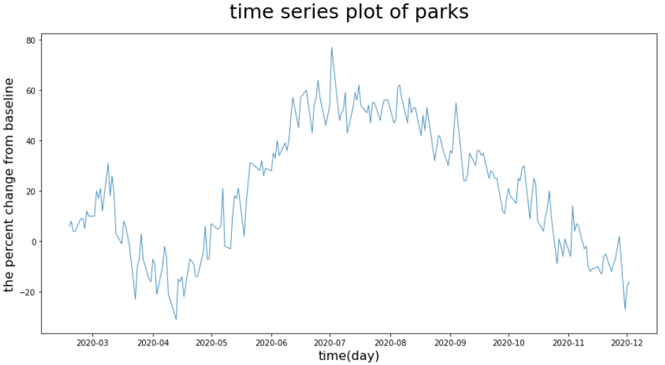
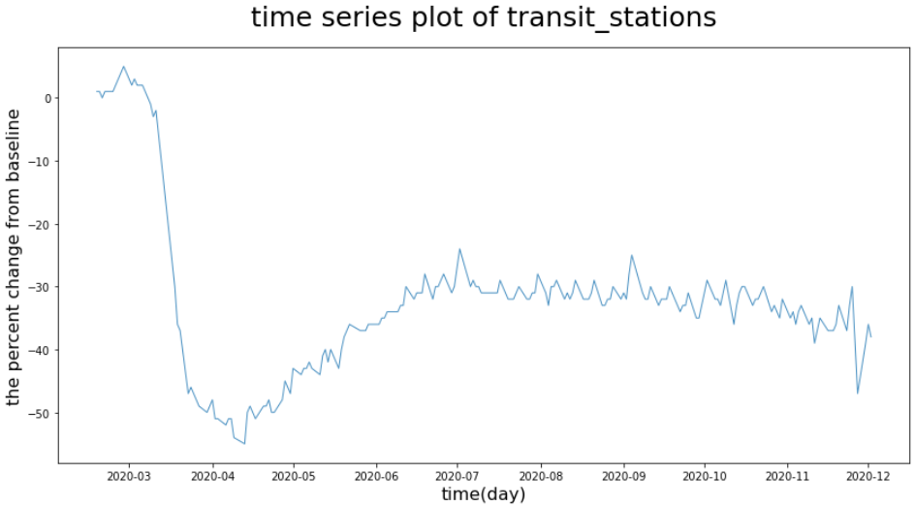
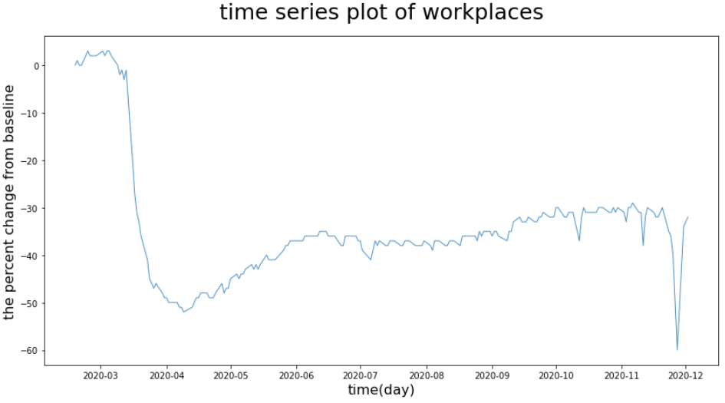
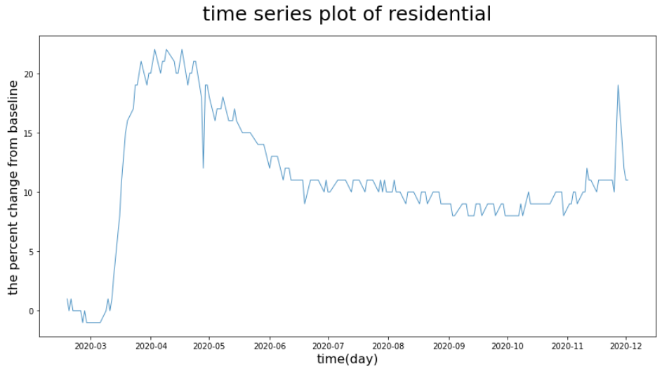
EDA Time Series Plot

Slide 19
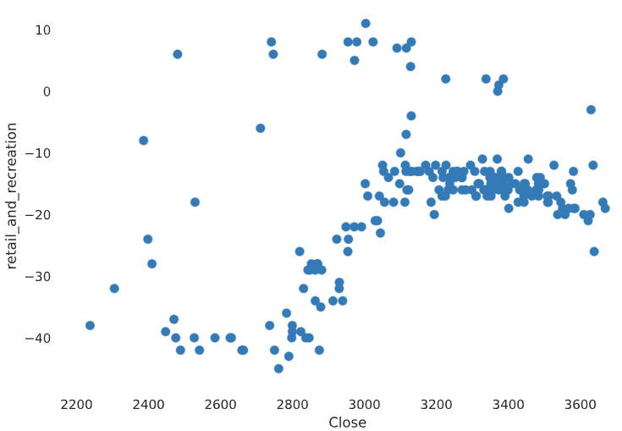
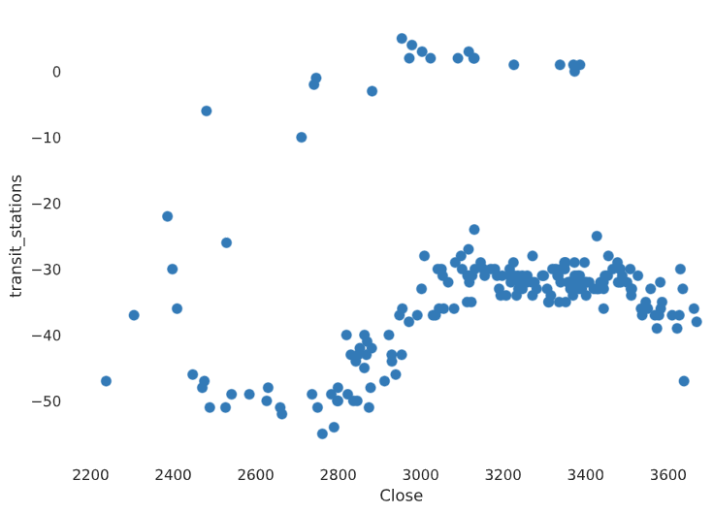
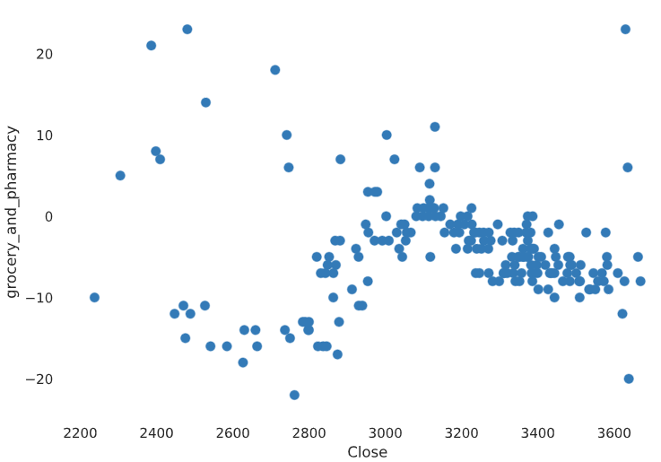
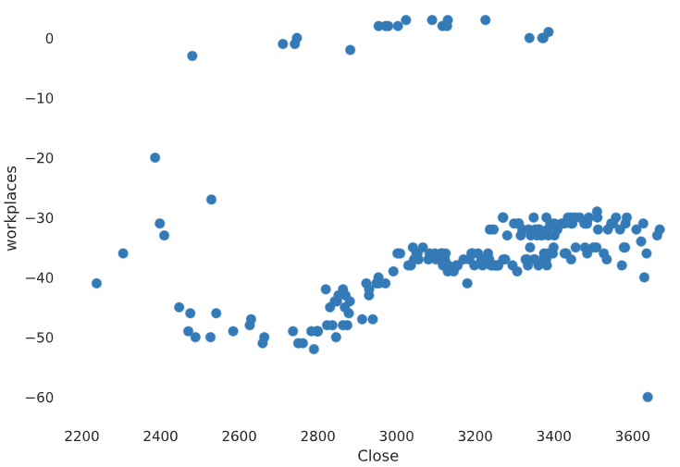
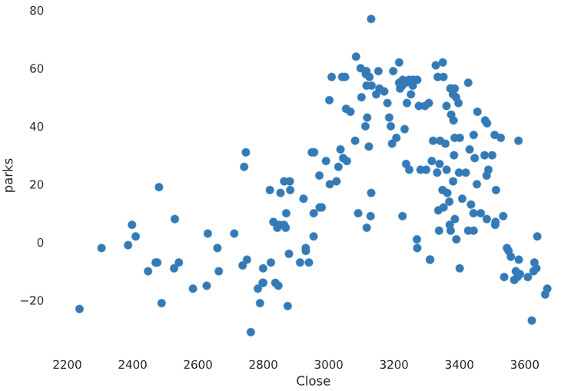
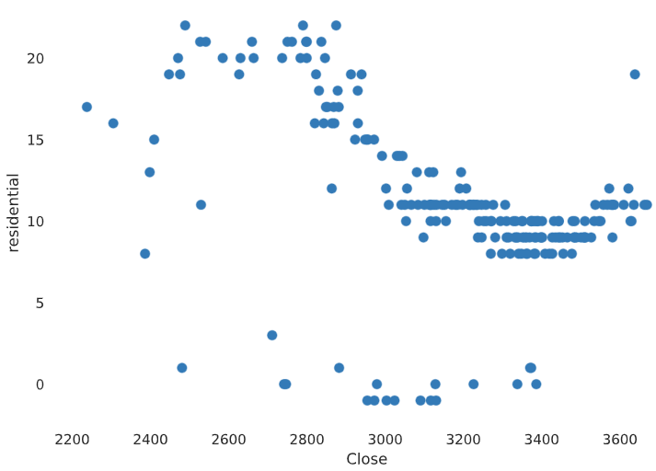
EDA Scatter Plot (S&P 500 Index)

Slide 20
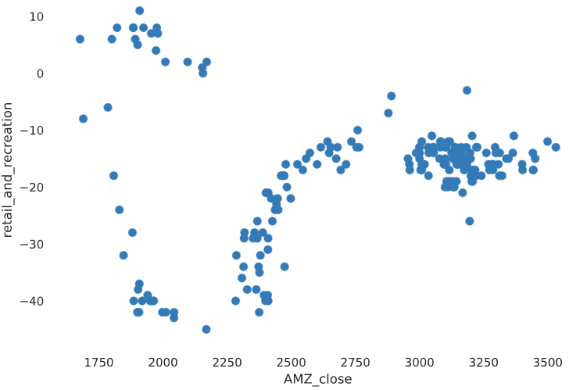
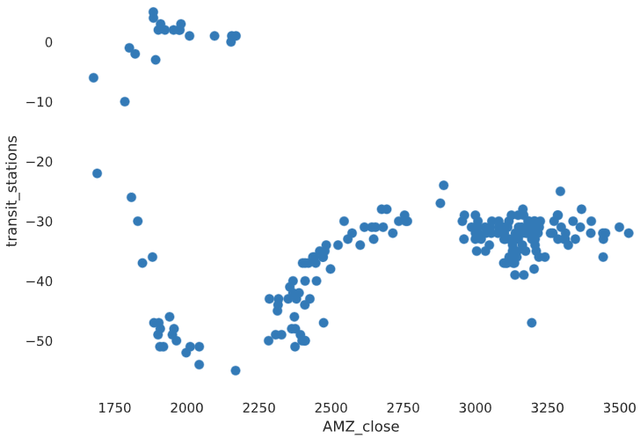
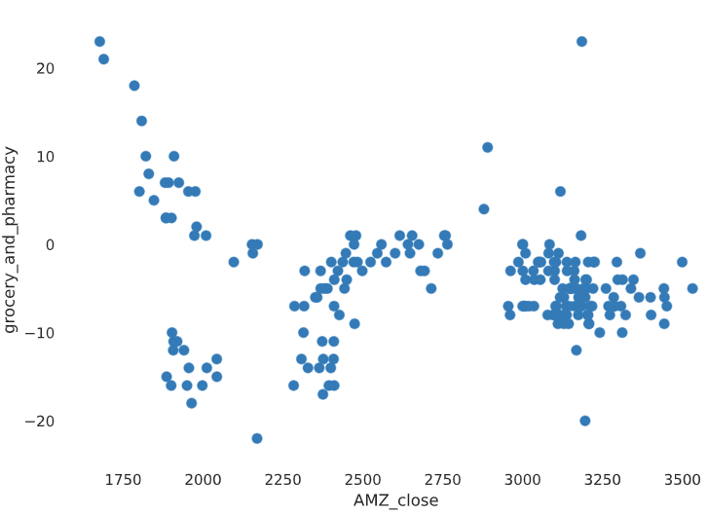
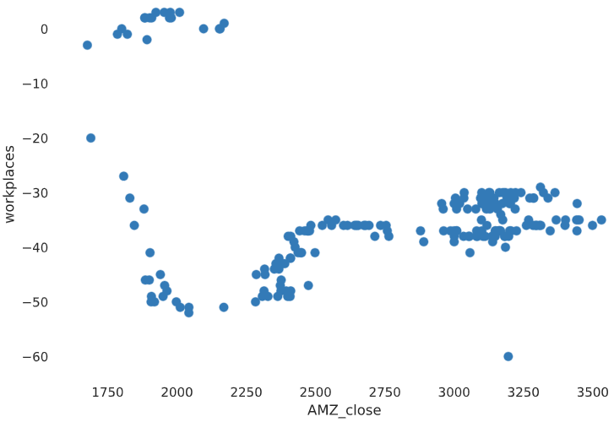
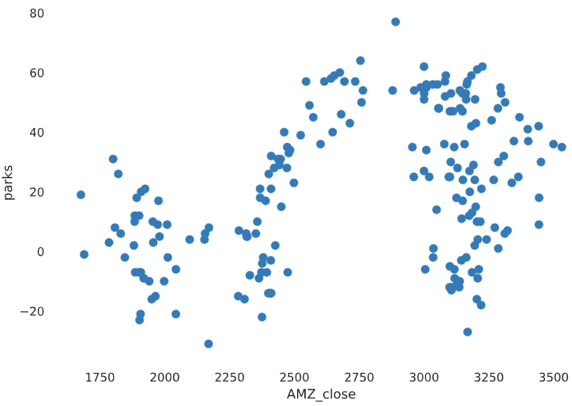
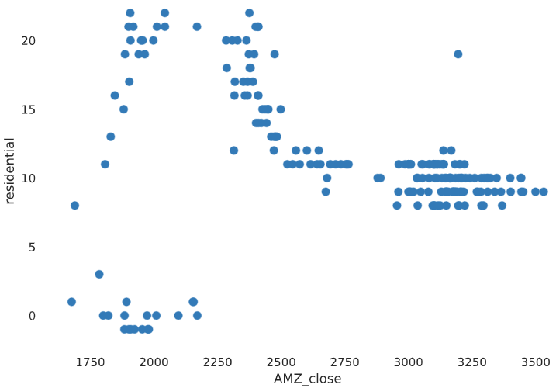
EDA Scatter Plot (Amazon stock)

Slide 21
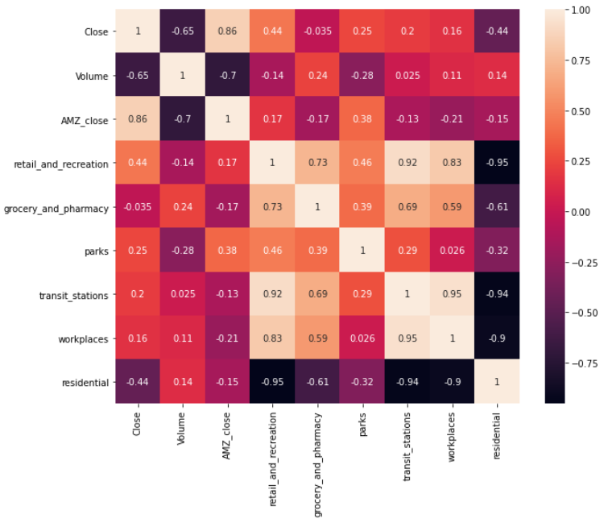
EDA Heatmap
High correlation between:
S&P 500 Index and Amazon stock
High correlation with S&P 500 Index:
Retail_and_recreation
Residential
High correlation with Amazon stock:
Parks

Slide 22
Regression Model
Performance of predicting the close of S&P 500 index
Algorithm | Best Accuracy(%) | Evaluate with test set
 |  | R^2 Score | RMSE Score
Linear Regression | 73.76942 | 0.66505771 | 158.59809669
KNN | 78.26820 | 0.75066534 | 136.83723997
Random Forest | 72.33759 | 0.85739412 | 103.48602105

Slide 23
Regression Model
Performance of predicting the close of Amazon stock
Algorithm | Best Accuracy(%) | Evaluate with test set
 |  | R^2 Score | RMSE Score
Linear Regression | 78.94861 | 0.79785606 | 218.31509124
KNN | 83.30294 | 0.79865281 | 217.88442449
Random Forest | 83.22301 | 0.88624928 | 163.76854107

Slide 24
Summary
There is a relatively high correlation between consumer movement/outdoor activity and S&P 500 Index as well as Amazon stock
Before July or so, less consumer movement/outdoor activity negatively affect the S&P 500 Index/economy. After that time point, this effect disappeared. It has the same effect on Amazon stock. But Amazon stock cannot fully represent online shopping sales.
The regression model of predicting the stock price by using the data of mobility is available even though the performance is not perfect

Slide 25
More Data From 2/18/2020 to 12/02/2020
Use S&P 500 Index and Google Consumer Mobility data again as a proxies
Use Disney stock as a proxy for outdoor events and general entertainment industry
Source: https://finance.yahoo.com/quote/DIS/history?p=DIS
Notes:
So since we used Amazon stock as a proxy to gauge the performance of online shopping, we decided it would be beneficial to also single out a company which may be a good proxy to indicate the performance of the outdoor activity and entertainment industry. In this case, we chose DIsney since their parks are incredibly popular and operate so many projects which require lots of people in one area, whether it is for film, animation or otherwise, that it would be a good indicator of the other side of the market affected by the COVID-19 pandemic.

Slide 26
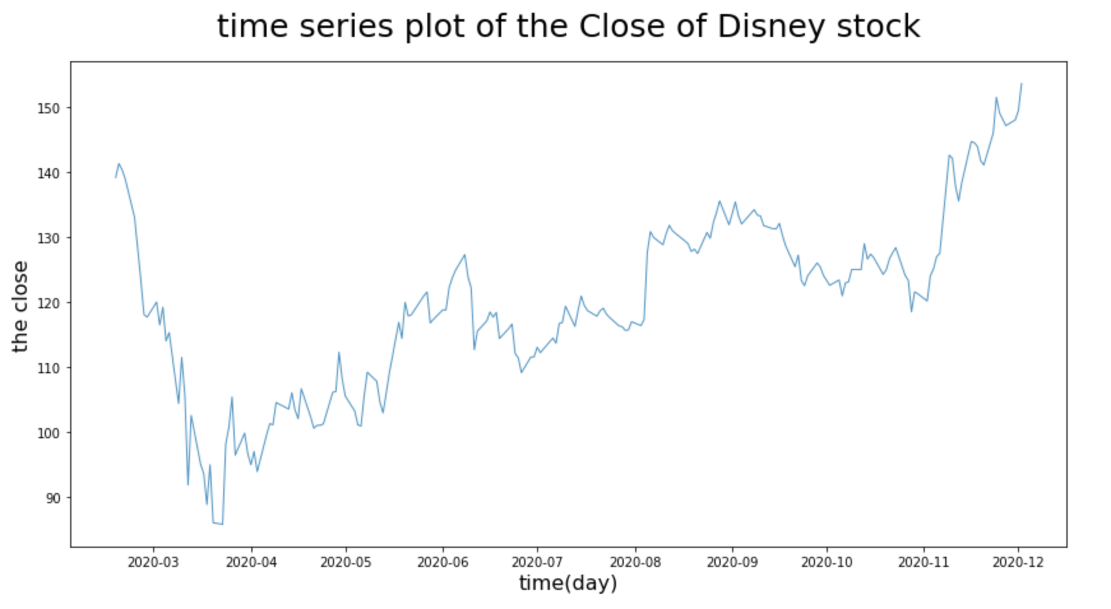
EDA Time Series Plot
Notes:
I won’t go over the graphs discussed before since Tianyi has already taken care of them, so I will be specifically referring to the differences in outcomes observed when comparing the data to Disney. Visually speaking, we can see how there is quite a difference between how each companies’ stocks fared during the pandemic. Not only does it look like Disney follows the trend of the S&P 500 more closely than Amazon does, but you can also see how drastically affected Disney’s stock was as well as their struggle to get their market price back to where it was before March. Meanwhile, Amazon has substantially increased in their stock price and matched what they had at the beginning of this data set between April and May of 2020, and Disney took until between November and December of 2020. This is where you can really see the difference of the impacts the pandemic took on these different industries.

Slide 27
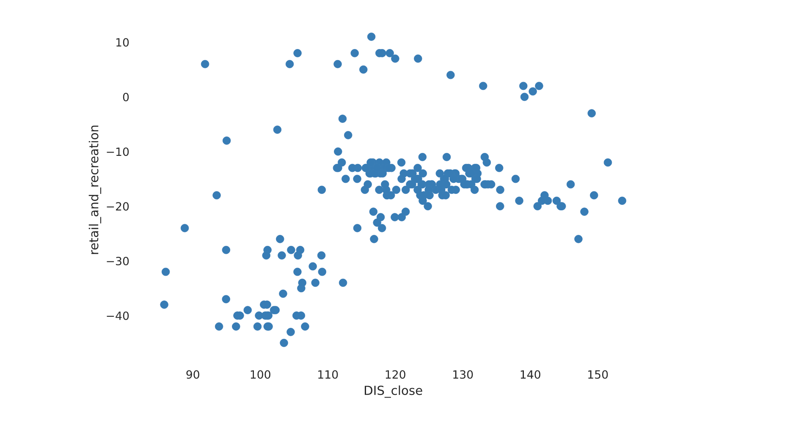
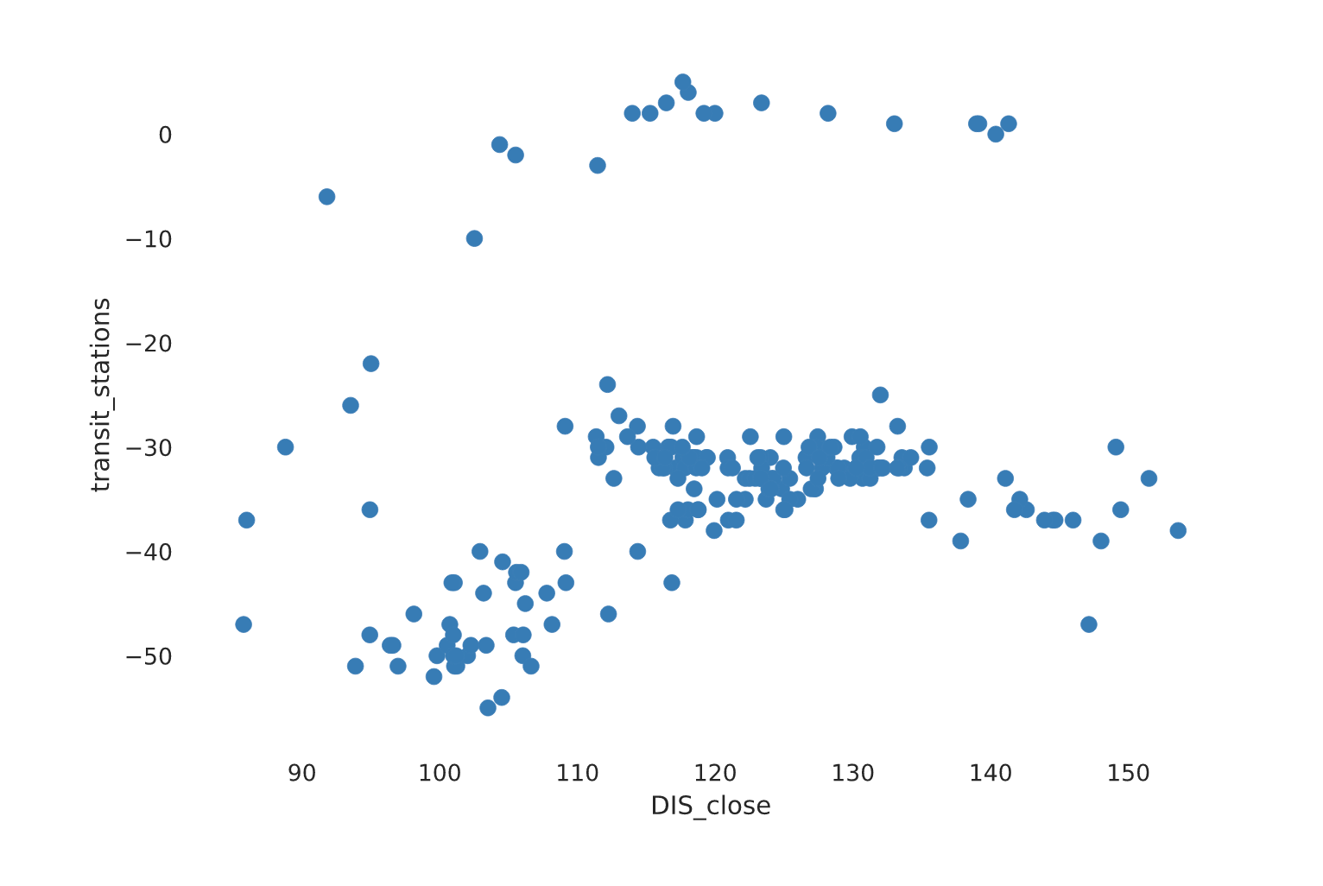
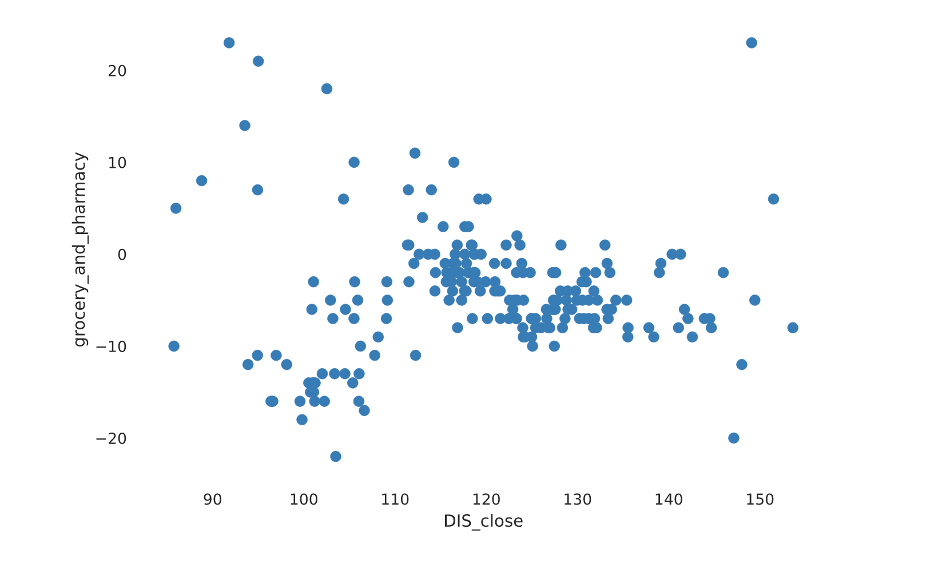
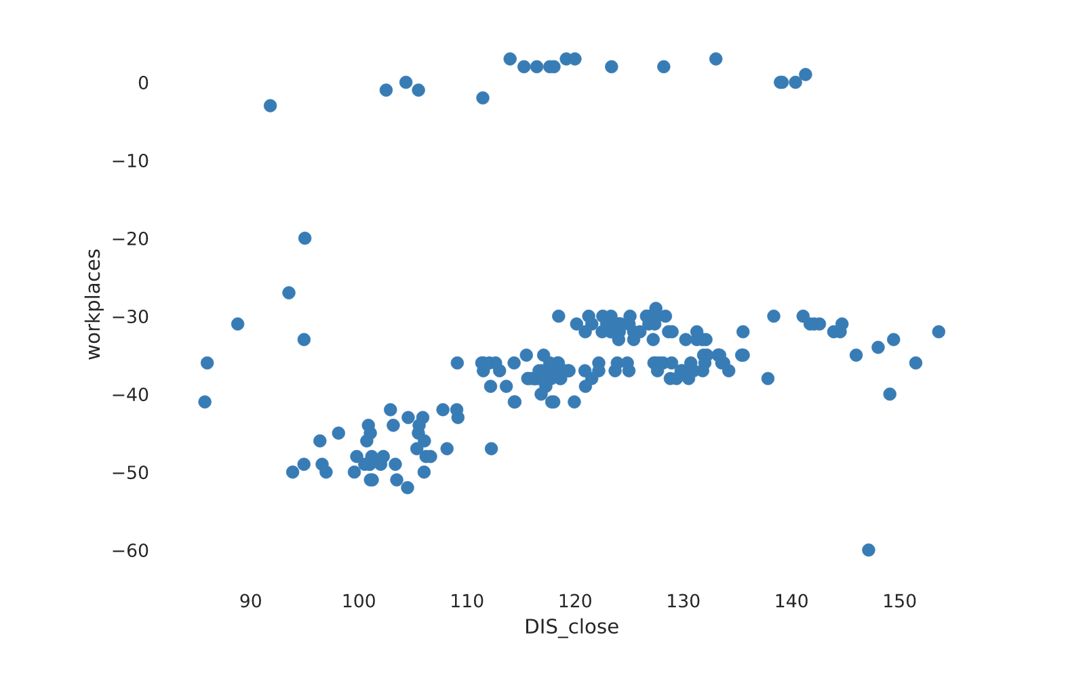
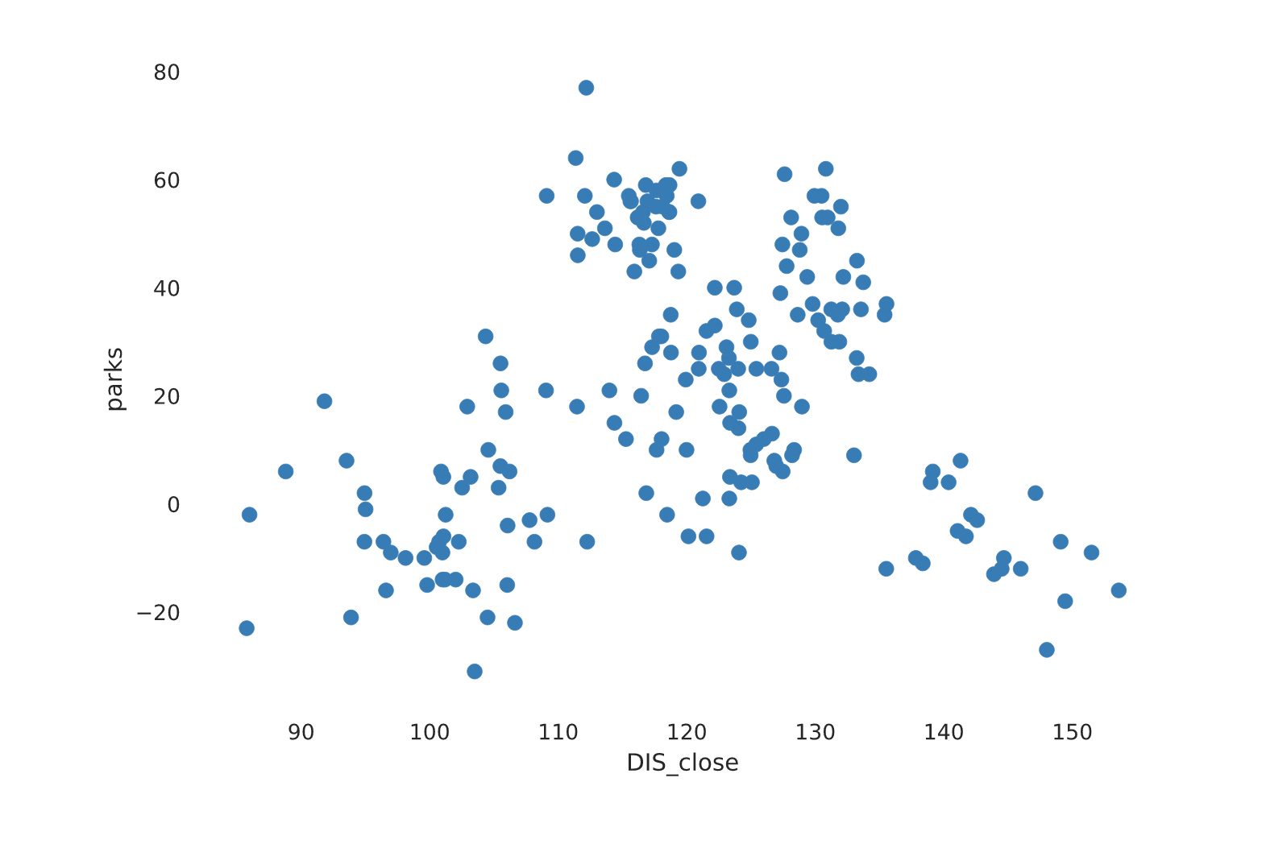
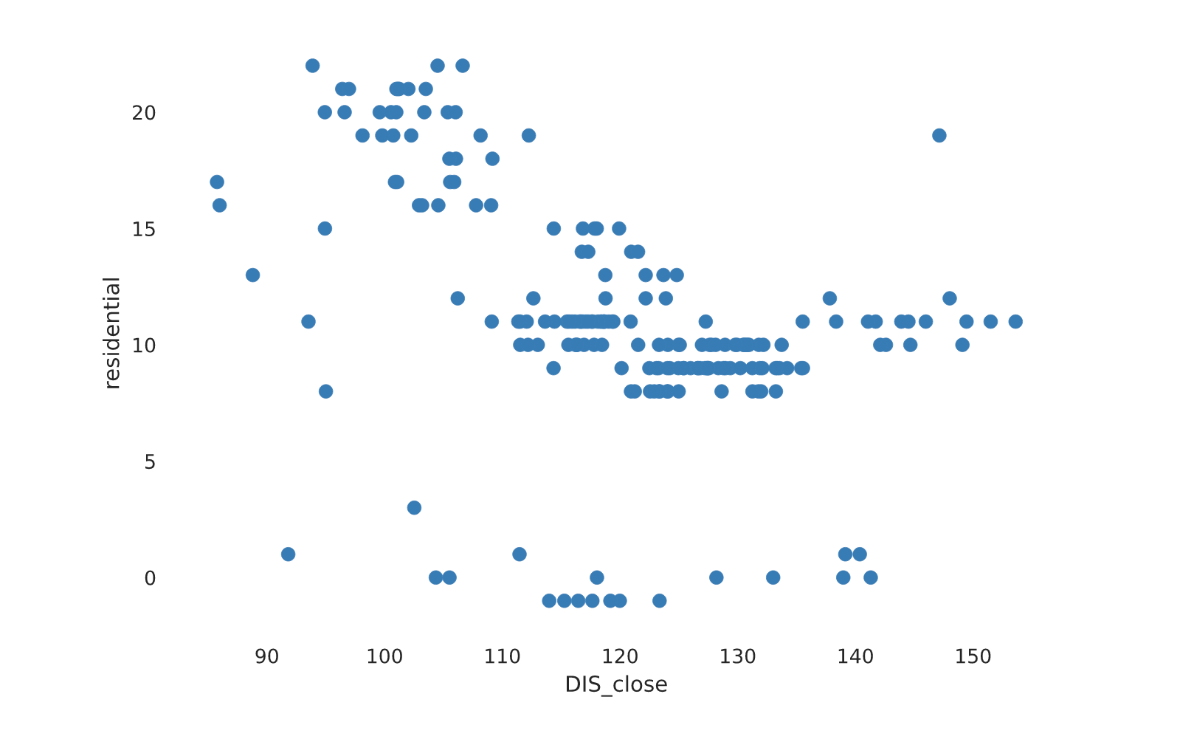
EDA Scatter Plot (Disney stock)
Notes:
Here’s more scatter plots showing Disney’s closing numbers plotted against various stats. They do seem to be more loosely correlated which can also be on the following heatmap.

Slide 28
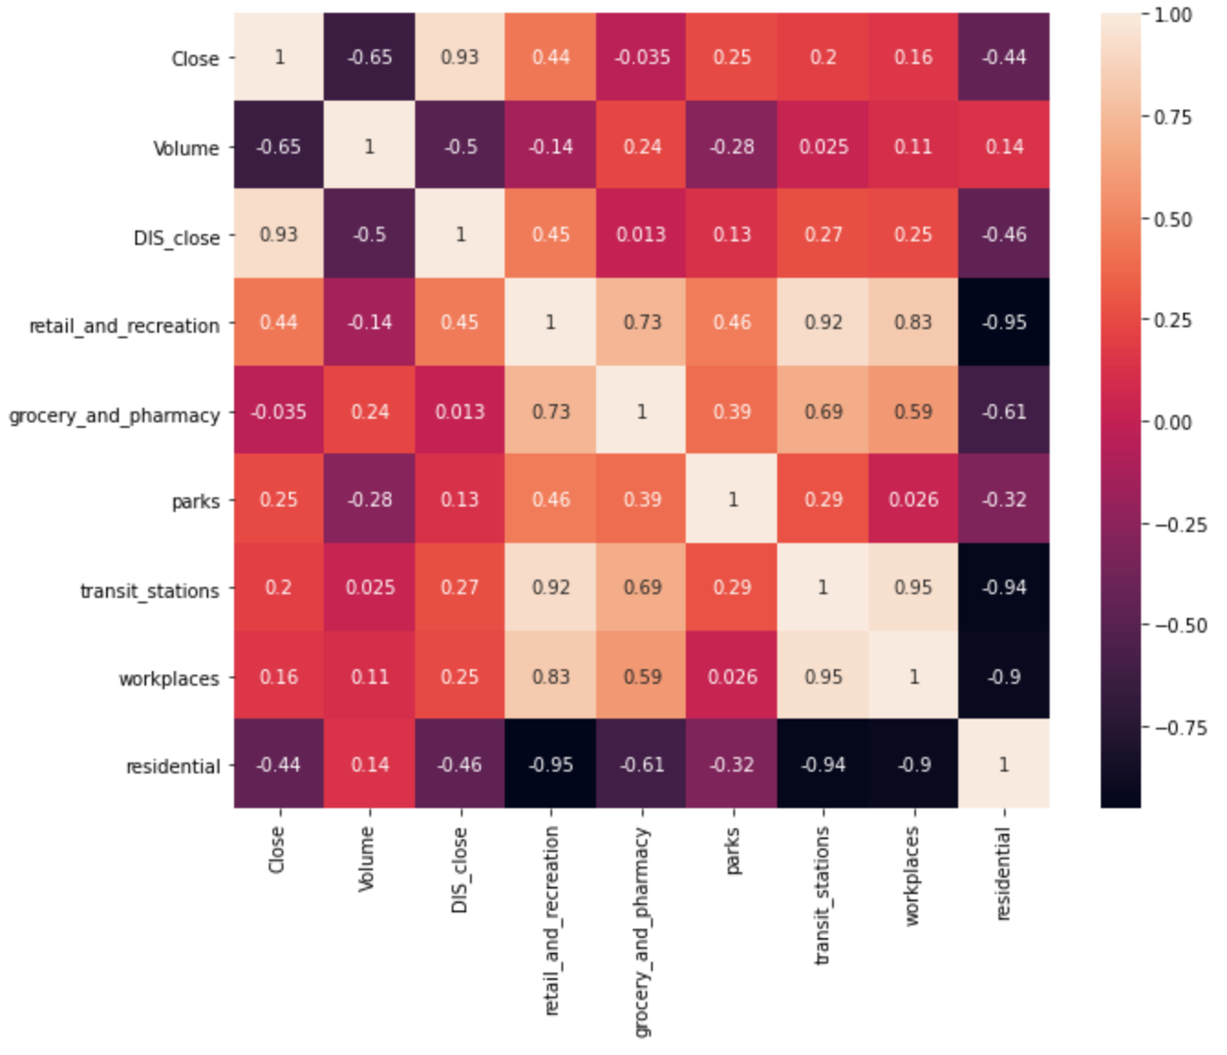
EDA Heatmap
Notes:
Here is the heatmaps using the closing numbers for both Amazon and Disney correlated with other factors highlighted by the blue circles. Some interesting correlations we see from this map are that Disney’s closing price correlated more with the S&P 500’s closing price than Amazon’s did. We can also see that there was some correlation between Disney’s closing price and retail and recreation but also with residential, closely resembling the correlation these two factors have with the S&P 500 index.

Slide 29
Regression Model
Performance of predicting the close of S&P 500 index
Algorithm | Best Accuracy(%) | Evaluate with test set
 |  | R^2 Score | RMSE Score
Linear Regression | 78.94861 | 0.79785606 | 218.31509124
KNN | 83.30294 | 0.79865281 | 217.88442449
Random Forest | 83.22301 | 0.88624928 | 163.76854107
Amazon
Algorithm | Best Accuracy(%) | Evaluate with test set
 |  | R^2 Score | RMSE Score
Linear Regression | 59.17370 | 0.39261053 | 9.1074727831
KNN | 70.64735 | 0.67017111 | 6.7113300633
Random Forest | 66.91842 | 0.81444365 | 5.0338718551
Disney
Notes:
So here are some results from testing the impact of consumer mobility on Disney and Amazon’s stock prices. As mentioned before by Tianyi, we wanted to see how well consumer mobility could be used to help predict stock prices for each of these companies. For disney, it was surprising to see Linear Regression perform so poorly with its low accuracy and R^2 score. The RMSE score is very different from Amazon’s since the price of Disney is much smaller compared to the S&P 500. We can see that Random forest performs the best with Disney’s data as well, but the accuracy of the predictions is lower than Amazon’s which may be important in seeing the impact of consumer movement and these stocks.

Slide 30
Overall Summary
Consumer movement is highly correlated with the stocks of both Amazon and Disney as well as the S&P 500.
While they are both highly correlated, it seems that the negative effect lasted longer on Disney than it did for Amazon. Amazon was quick to bounce back around the summer while Disney did not recover its price until late November into December
Even though these are both good companies to represent their industries, there are still many other companies and factors to consider.
Notes:
Overall, we can see from this data that there is significant correlation between stocks and consumer movement. We have also seen that Disney ended up becoming way more impacted throughout the pandemic and took a longer time to recover than Amazon, maybe being reflective of the lack of outdoor activity and entertainment while online shopping was still possible. It is not enough to only look at these two companies and make statements on the industry as a whole, but these statistics do provide food for thought with how the economy was affected by consumer mobility. We still have seen a very strong comeback in the S&P 500 which was helped a lot by Amazon’s stock but may have been at the expense of companies like Disney.

Slide 31
03
Research Question 3
Can we use Consumer Movement to predict rates of COVID-19 transmission?

Slide 32
Data
Used daily increase in covid cases or deaths as target variables.
Used google Consumer Mobility data including:
Retail & Recreation
Grocery & Pharmacy
Parks
Transit Stations
Workplaces
Residential
These made up 6 features used in LDAs to predict covid data.
The covid data was used with a 2 week offset from the consumer movement data to provide time for cases to register (IE consumer data from 4/1 matched with covid data from 4/15)

Slide 33
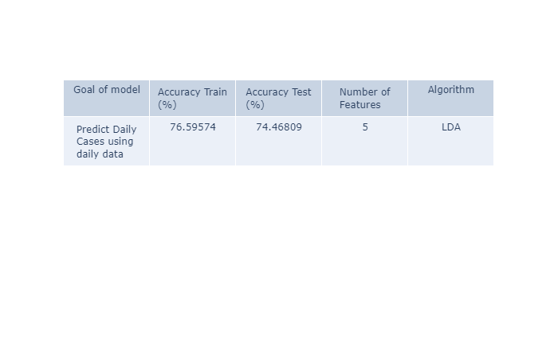

First Attempt
The first thing I tried was to apply basic LDAs for Cases and deaths. This yielded mixed results.

Slide 34
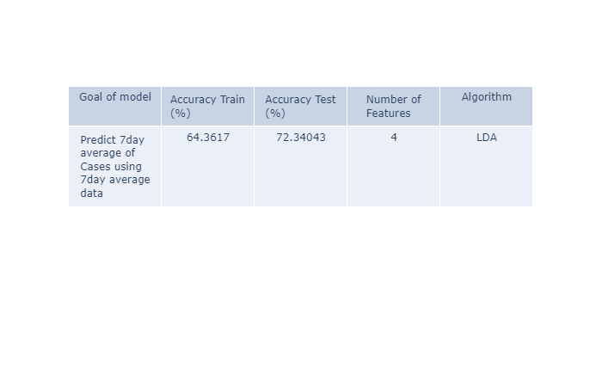

7 day averages
I wanted to see if I could get a better model using 7 day averages for both covid data and the movement data.

Slide 35
Largest confounding variable: Testing!!
The largest confounding variable appeared to be testing. In roughly the first half of the dataset testing is significantly lower than it is in the second half. This means the rate at which cases are detected is not proportional between the two parts of the same dataset.
This led me to wonder what happens if we split the dataset in half?

Slide 36
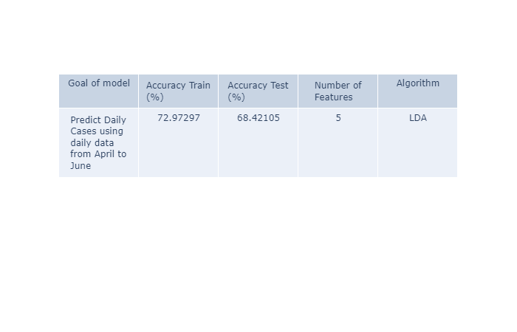

April to June
I picked the end of June to split the data as that is when testing started to pick up. Below are the models using data from April to June:

Slide 37
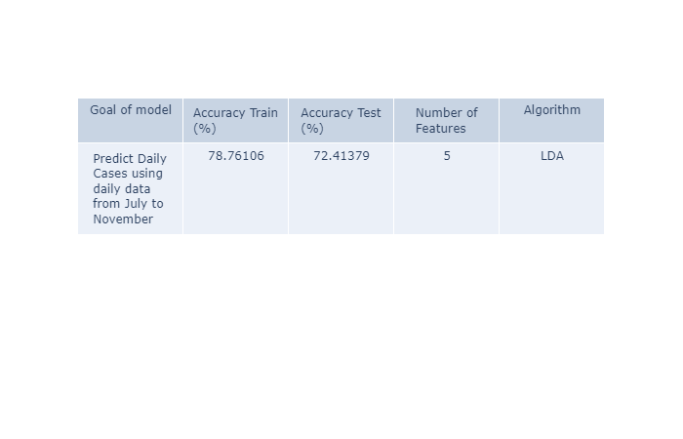

July to November
The second half of the data lead to the best models yet for predicting an increase in daily deaths from July to November:

Slide 38
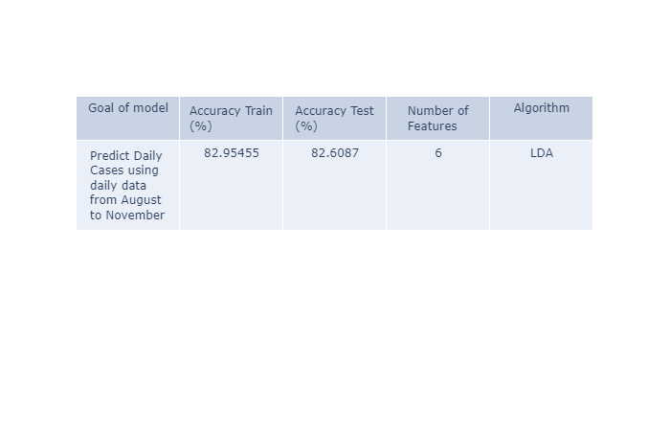

August to November
I was still not satisfied with the model for predicting an increase in daily cases so I cut out July when testing was still not great leading to August to November:

Slide 39
Can We Use Consumer Movement to Predict an Increase in Covid Cases and Deaths?
Covid data from before August is not very reliable due to lack of testing.
The first model is probably more accurate than it seems due to this unreliable covid data.
Consumer movement can, in fact, be used to accurately predict spikes in covid cases as long as enough testing is being done.
Predicting an increase in deaths is more unreliable than cases. This is likely due to the fact that deaths can occur much more than 2 weeks after a patient contracts covid.

Slide 40
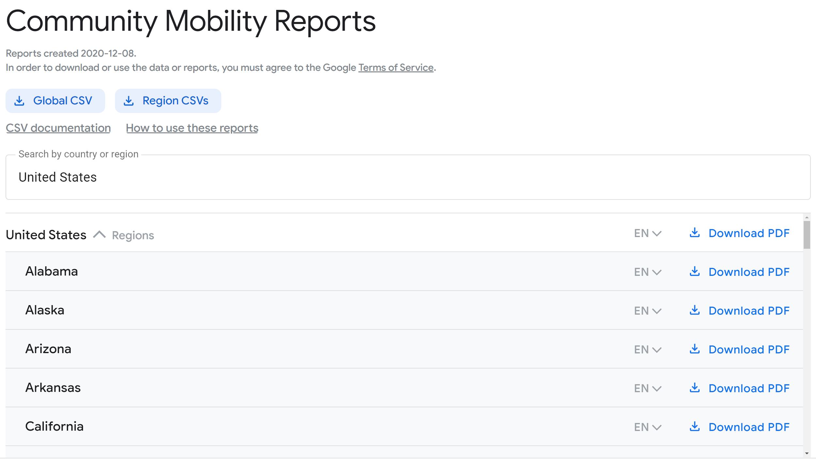
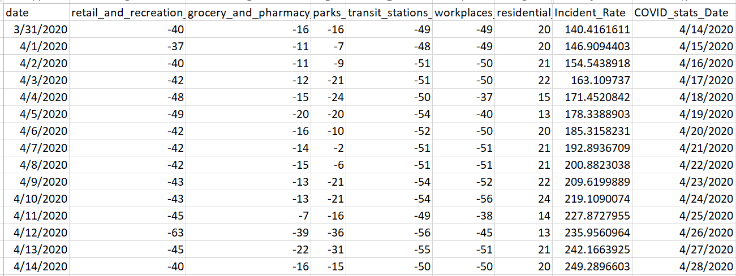
Consumer Movement Regression Model
Data

Slide 41
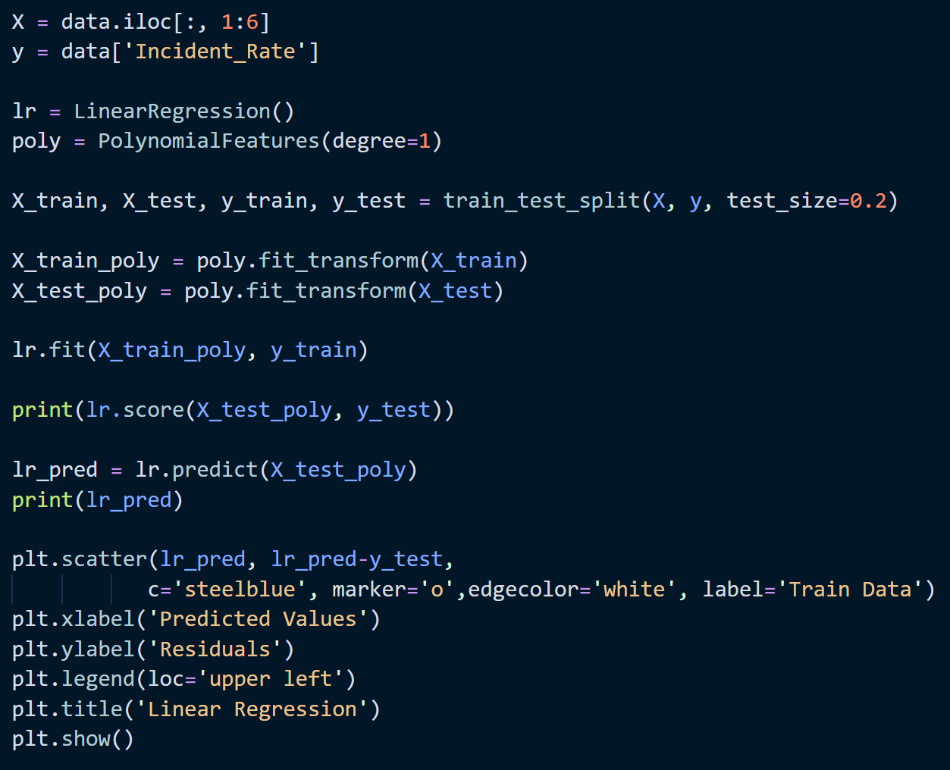
Consumer Movement Regression Model
Model Training
Linear Regression
Polyfit of Degree 1
Train-Test Split 80% - 20%
R^2 to test accuracy

Slide 42
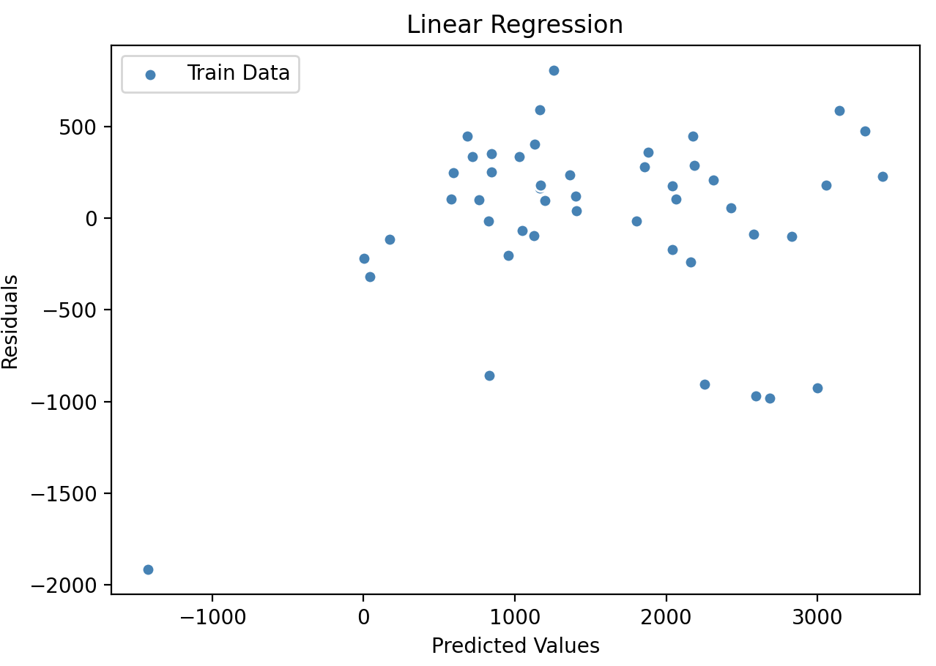
Consumer Movement Regression Model
Results
R^2: 0.76842

Slide 43
Summary
Consumer Movement Data is able to create good regressors and classifiers for COVID-19 Incident Rates.
Better data and better testing practices could make these into reliable models
We are limited by the data we have

Slide 44
04
Conclusion

Slide 45
Results Summary
Research Question 1
Research Question 2
Research Question 3
Sentiment was a better predictor than Factual Data
Less consumer movement/outdoor activity negatively affected the economy and online shopping
Consumer Mobility data can be used as a predictor of COVID-19 cases

Slide 46
THANK YOU
If you have any questions, feel free to submit it as a comment in the discussions below
Please keep this slide for attribution.

